Slide 1
Supermarket Sales Data Analysis with SQL
In this project, I used SQL to analyze the Supermarket Sales Dataset sourced from Kaggle. The dataset contains detailed sales transaction records from a supermarket chain in Myanmar, across three cities: Yangon, Naypyitaw, and Mandalay.
My goal was to demonstrate SQL querying capabilities to derive meaningful insights from the data and showcase the skills needed for effective data analysis.

Slide 2


1. Total Number of Transactions
This query counts the total number of transactions in the table.

Slide 3
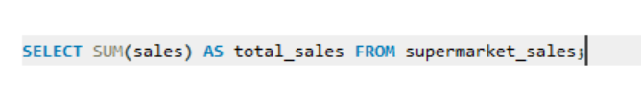

2. Total Sales Amount
This query calculates the total sales revenue generated during the time frame. It provides an overview of the supermarket's financial performance.

Slide 4
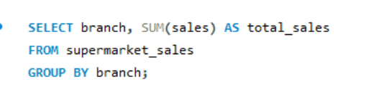
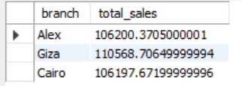
3. Sales by Branch
This query aggregates total sales by branch. It allows us to compare sales performance across different locations of the supermarket.

Slide 5
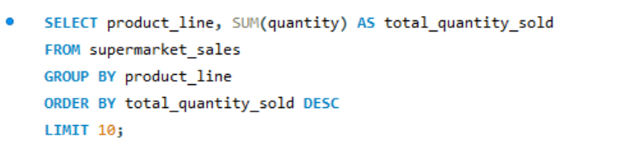
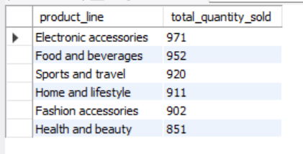
4. Total quantity sold Product
This query identifies the top-selling products based on quantity sold. It helps to recognize customer preferences and popular items.

Slide 6


5. Average unit price of products_line
This query calculates the average price of products sold. It gives insights into pricing strategy and customer spending behavior.

Slide 7
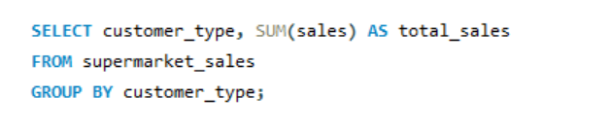

6. Sales by Customer Type
This query sums sales based on customer types (e.g., member or normal). It helps in understanding which customer segment contributes more to the sales.

Slide 8
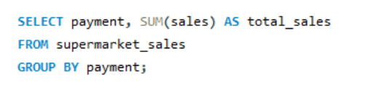
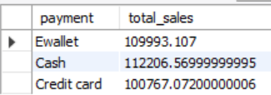
7. Total sales by Payment method
This query provides insights into how customers prefer to pay (e.g., cash, credit).

Slide 9

8. Count of unique Customer
This query counts the unique transactions (invoices), reflecting the number of distinct customers during the analysis period. It helps assess customer reach.

Slide 10
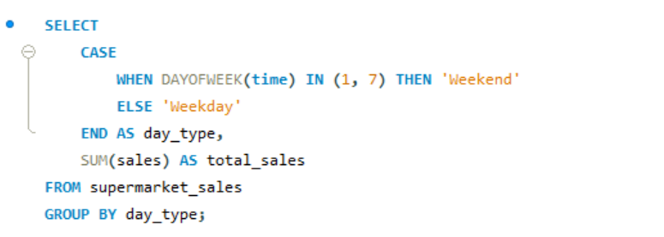

9. Sales on Weekdays VS Weekend
This query categorizes sales into weekdays and weekends. It helps in analyzing sales patterns based on the day of the week, which is useful for staffing and promotions.

Slide 11
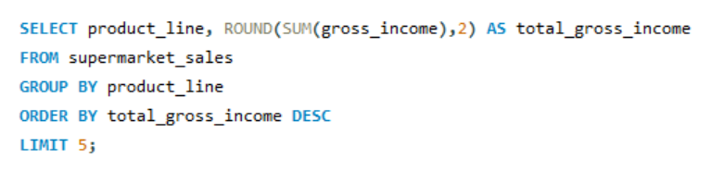
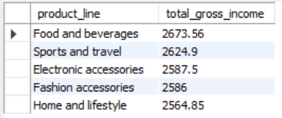
10. Top 5 highest gross income product
This query identifies the products generating the most gross income.

Slide 12
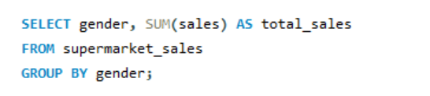

11. Sales by Gender
This query analyzes total sales based on customer gender. It can inform targeted marketing strategies and product offerings.

Slide 13
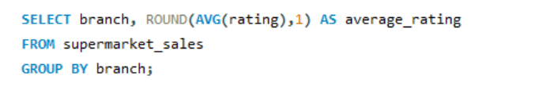
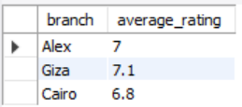
12. Average rating by Branch
This query calculates the average customer rating for each branch. It helps assess customer satisfaction and service quality across locations.

Slide 14
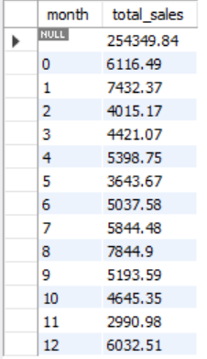
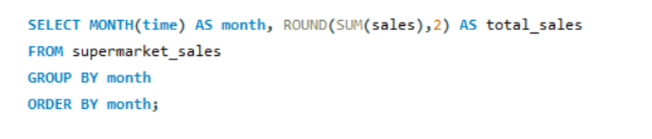
13. Sales trends over time(Montly)
This query reveals monthly sales trends. It allows for the identification of seasonal patterns or anomalies in sales performance.

Slide 15
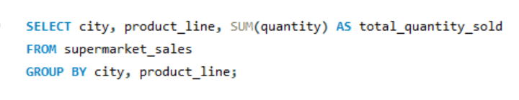
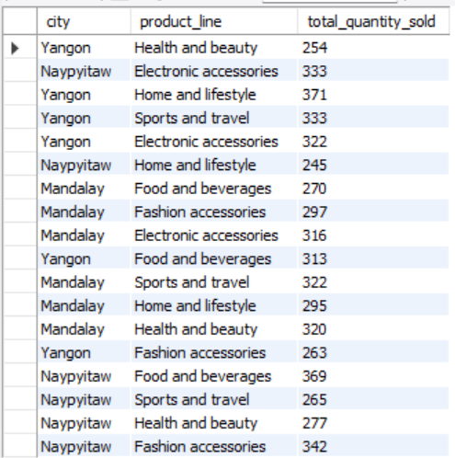
14. Product sold by city
This query examines product sales across different cities. It can help tailor marketing efforts to local preferences and demands.

Slide 16
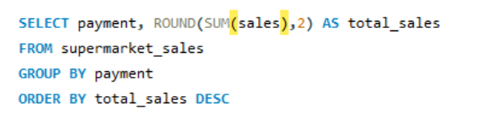
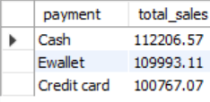
15. Top 3 Payment methods by sales
This query lists the most popular payment methods by sales volume. It aids in understanding customer behavior regarding payment preferences.

Slide 17
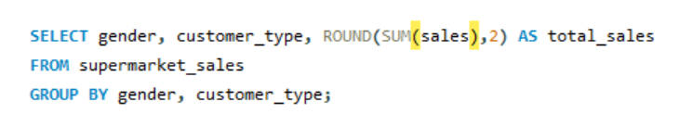
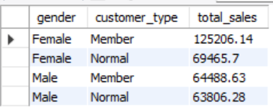
16. Sales Distribution by Gender and Customer type
This query provides insights into sales distribution across gender and customer type. It helps identify segments that perform well or need attention

Slide 18
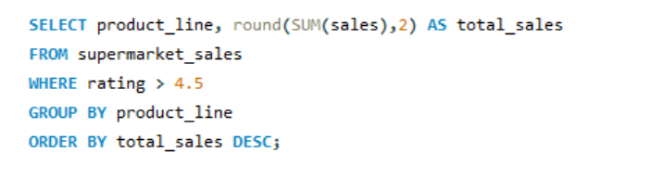
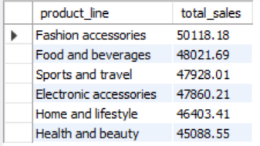
17. Sales for the highest rating product.
This query focuses on sales from products with high ratings. It emphasizes the relationship between product quality and sales performance

Slide 19


18. Total Tax Collected
This query calculates the total tax collected from sales. It provides insight into the revenue generated from taxes and financial compliance.

Slide 20
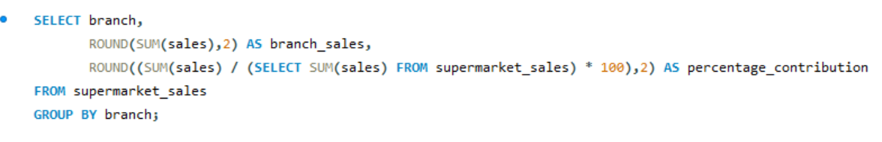
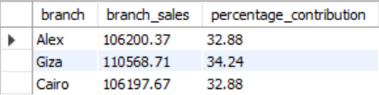
19. Percentage contribution of each branch to total Sales
This query calculates each branch's percentage contribution to overall sales. It helps identify the most successful branches in driving sales.

Slide 21
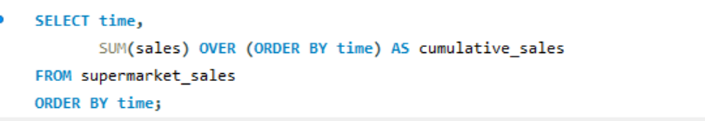
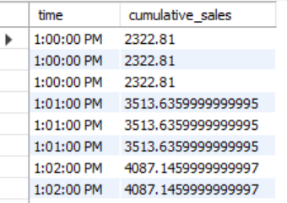
20. Cumulative sales over time
This query shows the cumulative sales growth over time. It helps visualize trends and growth patterns in sales performance.

Slide 22
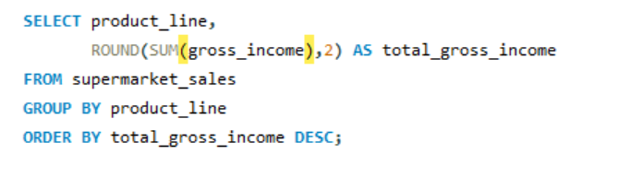
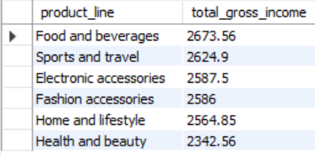
21. Most profitable product
This query highlights the products that generate the highest gross income. It assists in making decisions about inventory and marketing focus.

Slide 23
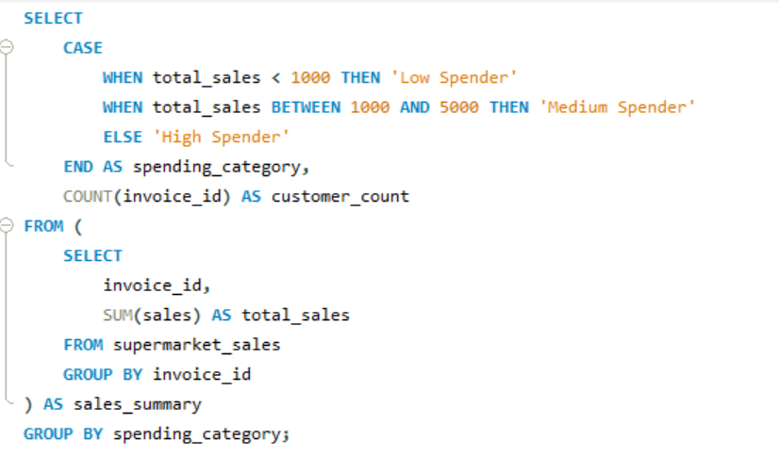

22. Customer Segmentation by Spending
This query segments customers into spending categories. It enables targeted marketing strategies based on customer spending behavior.

Slide 24
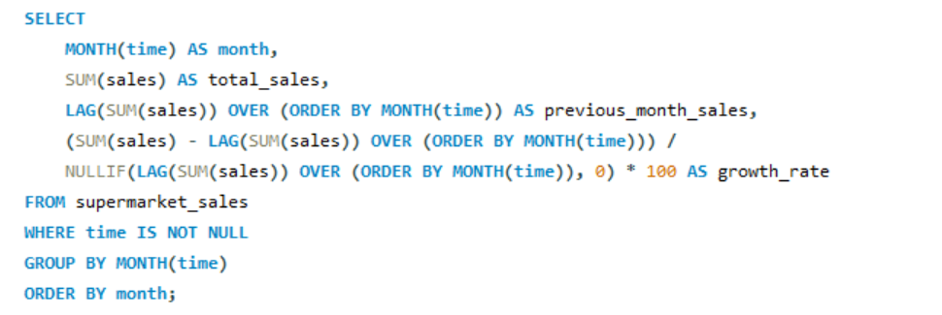
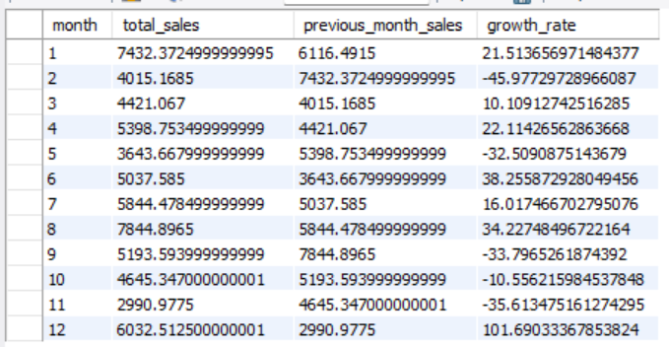
23. Sales Growth Comparison by Month:
This query compares monthly sales growth rates. It provides insights into performance changes over time and helps in forecasting future trends.

Slide 25
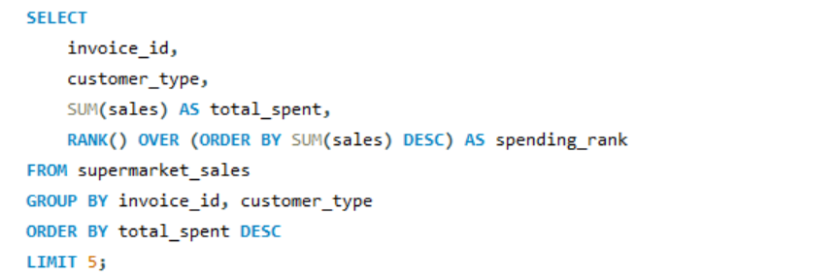
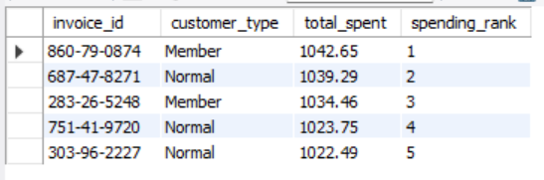
24. Top 5 Customer based on total Spending.
This query Finds the top 5 customers based on their total spending.

Slide 26
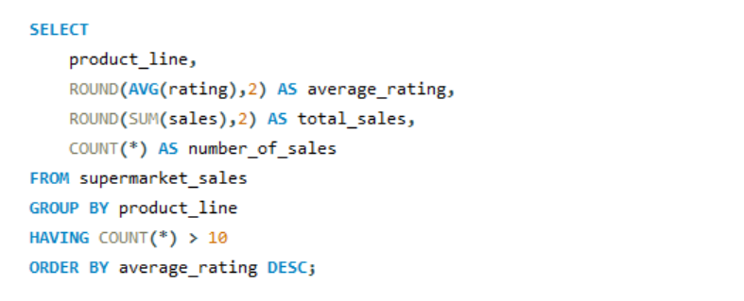
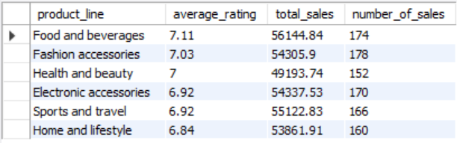
25. Analysis between Product rating and Sales
Analyzes whether higher-rated products generate more sales.

